Slide 1
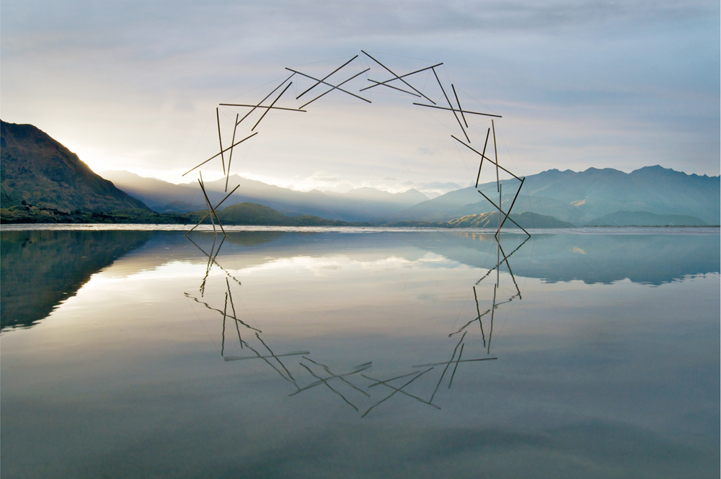
When Life Goes in Circles
(1:1-11)
Ecclesiastes
Dr. Rick Griffith • Crossroads International Church Singapore
CICFamily.com • BibleStudyDownloads.org

Slide 2
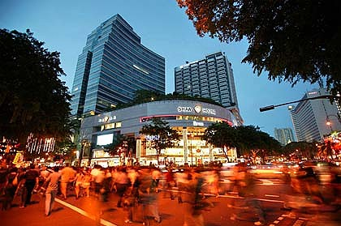
How many seconds do you take to walk 60 feet?
Singapore 10:55
New York 12:00
Blantyre, Malawi 31:60
Notes:
Interest: People in Singapore walk faster than any other city (http://odb.org/2014/06/21/worlds-fastest-walkers/).
Our Daily Bread notes, "According to a study measuring the pace of life of cities in 32 countries, people in the biggest hurry live here in Singapore. We walk 60 feet in 10:55 seconds, compared to 12:00 seconds for New Yorkers and 31:60 seconds for those living in the African city of Blantyre, Malawi."
"But regardless of where you live, the study shows that walking speeds have increased by an average of 10 percent in the past 20 years. And if walking speed is any indicator for the pace of life, we are certainly much busier than before."

Slide 3

Do you walk fast?

Slide 4

Why so fast?

Slide 5

Rats often run in circles

Slide 6
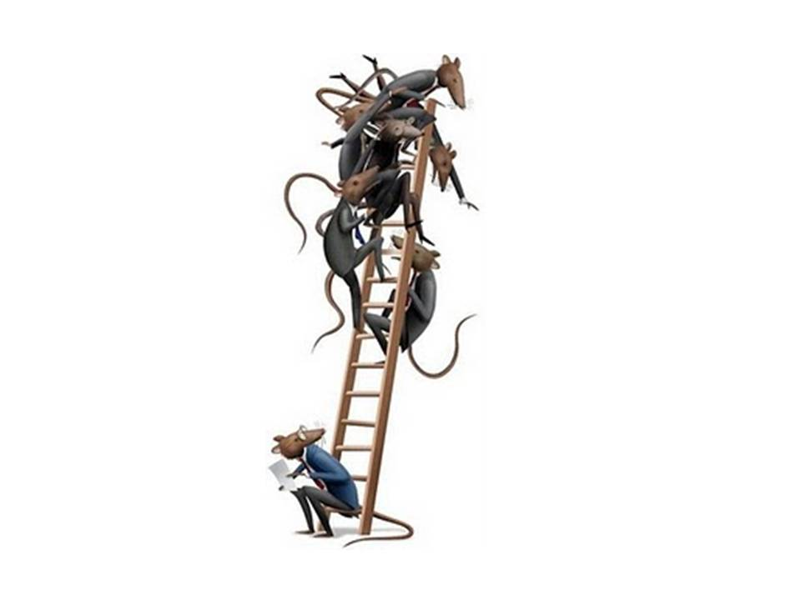
Rats climb the ladder
Are you climbing the ladder?

Slide 7
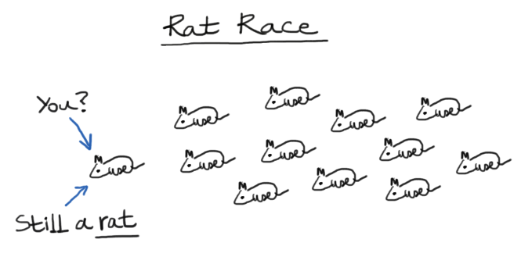
Still a rat
The Rat Race
You?
Still a rat.

Slide 8
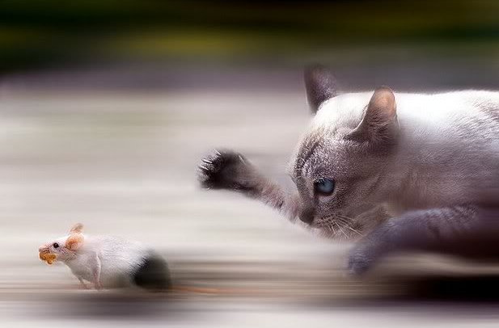
"Yeah, but if only you knew my boss…"

Slide 9
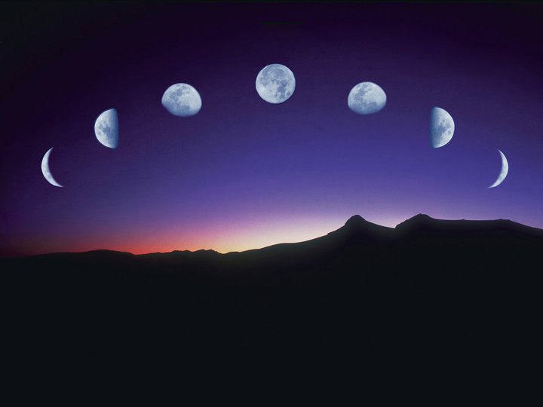
Our Study in Ecclesiastes
Work & Wisdom Don’t Last

Slide 10
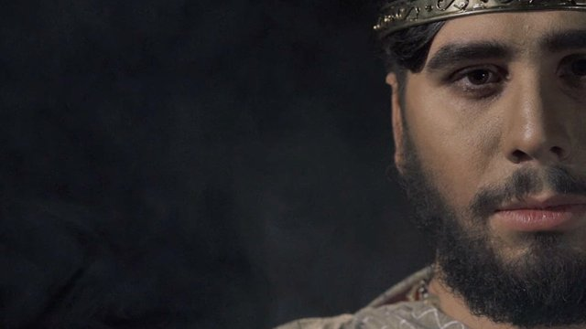


Ecclesiastes
A King's Ambition
CURRENT SERIES
Notes:
http://churchsermonseriesideas.com/?s=ecclesiastes image

Slide 11
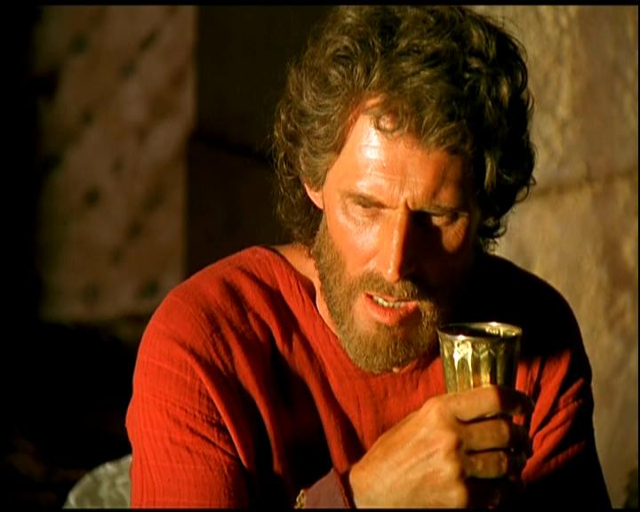
Many say Qohelet ("The Preacher") wrote it:
"Solomon" not used
"Later" words used
"I was king…" (1:12)

Slide 12
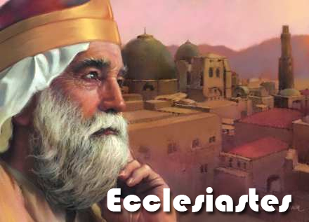
Befitting Solomon:
Wisdom (1:16)
Building (2:4-6)
Slaves (2:7)
Wealth (2:8a)
Harem (2:8b)
Proverbs (12:9)
Ecclesiastes
Notes:
http://churchsermonseriesideas.com/?s=ecclesiastes image

Slide 13

When was it written?
Ecclesiastes
Notes:
http://churchsermonseriesideas.com/?s=ecclesiastes image

Slide 14
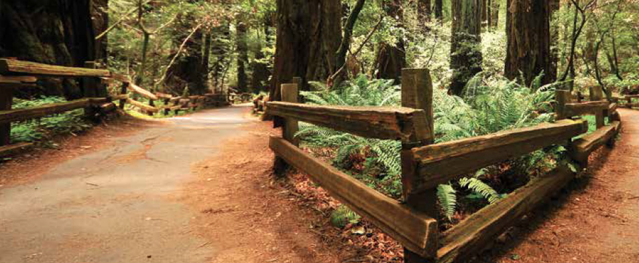
The OT Poetic Books
Job: how to suffer
Psalms: how to pray
Proverbs: how to relate
Song: how to love
Ecclesiastes: how to live

Slide 15

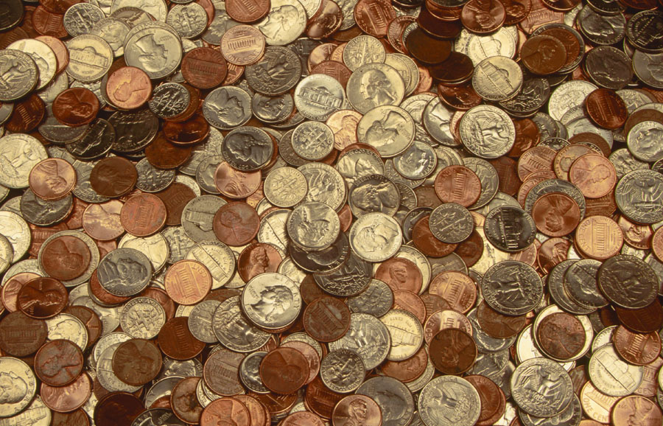
I. Every human endeavor is short-lived (1:2).

Slide 16
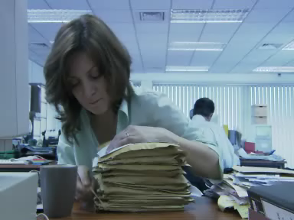
Video Clip
Vanity

Slide 17

1:2 KJV
The Hebrew Word Hebel
Vanity of vanities!
all is vanity!

Slide 18

Meaning of Hebel
lbh
"vanity" (KJV, ESV, NAU),
"meaningless" (NIV, NLT),
"futile" (NET, TLB, BKC)
"fleeting"
The Key Word of Ecclesiastes

Slide 19

Cover
Under the Sun
A Study of the Book of Ecclesiastes
Notes:
The Meaninglessness of Human Achievement & Wisdom

Slide 20
Hebel & "Under the Sun"
405
Word/Phrase | Generally Held Meaning | Other Options Offered
Hebel (1:2) | lit. "vapor, breath" (BDB 210d 1); "what is evanescent, unsubstantial, worthless, vanity" (BDB 210d 2); "meaningless" (NIV), "vanity" (KJV), "futile" (NET) | "enigmatic, mysterious" (Graham S. Ogden); "absurd" (Michael V. Fox); "irony" (Edwin Good); "fleeting" (Radmacher)
"under the sun" (1:3) | manner of observing life from a human perspective (Leupold) | sphere of man's earthly activity, i.e., "down here on earth" (Ardel B. Caneday)
Notes:
For "fleeting" meaning, see Tommy Nelson, A Life Well Lived: A Study of the Book of Ecclesiastes. Nashville, TN: B&H Publishing Group, 2005.
Radmacher, Earl; Ronald B. Allen & H. Wayne House, eds. Nelson's New Illustrated Bible Commentary. Nashville, TN: Thomas Nelson Publishers, 1999.

Slide 21
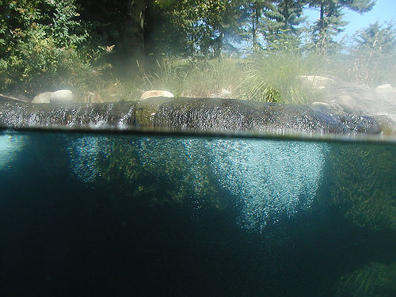
Two Ways to Look at Life
"enjoy life"
406
"fear God"
"keep his commandments"
"meaningless"
"under the sun"
Notes:
In this book it is as if Solomon is under water most of the time, declaring life to be "meaningless." Why? He is seeing life only "under the sun" in a horizontal perspective. It's the human view.
However, at various points he "comes up for air" only to advise his readers to "enjoy life" (2:24a; 12:13a, etc.) and to "fear God" (2:24b-26). The conclusion also tells us to "keep his commandments" (12:13b).

Slide 22


THE SEARCH FOR MEANING
Ecclesiastes

Slide 23
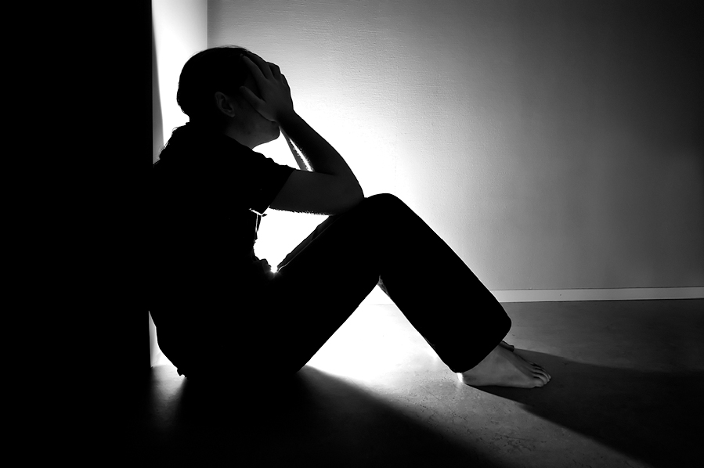
The Meaninglessness of Human Achievement & Wisdom
Ecclesiastes
But…
Is life really meaningless?
Was Solomon schizo?

Slide 24

Hebel literally means
"a breath, wind, or vapor"
(Prov. 21:6; Isa. 57:13).
Ecclesiastes

Slide 25
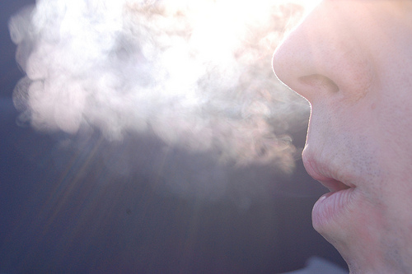
A Very Literal Translation
Metaphor:
what doesn’t last —"what is without real substance, value, permanence, significance, or meaning" (BKC, 1:976)

Slide 26
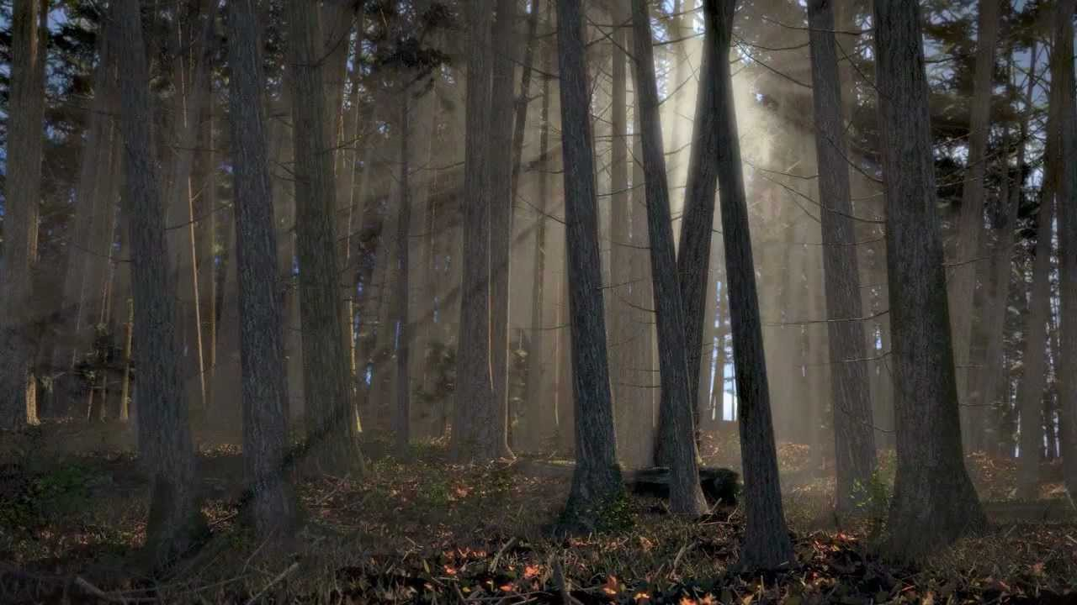
fleeting or transitory (6:12 with 3:19; 7:15; 9:9; 11:10)
What's wind or vapor like?
enigmatic or perplexing (6:2; 8:10, 14)
unseen and obscure (11:8).
BKC, 1:976

Slide 27
Fleeting
Passing
Brief
Temporary
Momentary
Transitory
Short-lived
Synonyms:

Slide 28
Hebel & "Under the Sun"
405
Word/Phrase | Generally Held Meaning | Other Options Offered
Hebel (1:2) | lit. "vapor, breath" (BDB 210d 1); "what is evanescent, unsubstantial, worthless, vanity" (BDB 210d 2); "meaningless" (NIV), "vanity" (KJV), "futile" (NET) | "enigmatic, mysterious" (Graham S. Ogden); "absurd" (Michael V. Fox); "irony" (Edwin Good); "fleeting" (Radmacher)
"under the sun" (1:3) | manner of observing life from a human perspective (Leupold) | sphere of man's earthly activity, i.e., "down here on earth" (Ardel B. Caneday)
Notes:
For "fleeting" meaning, see Tommy Nelson, A Life Well Lived: A Study of the Book of Ecclesiastes. Nashville, TN: B&H Publishing Group, 2005.
Radmacher, Earl; Ronald B. Allen & H. Wayne House, eds. Nelson's New Illustrated Bible Commentary. Nashville, TN: Thomas Nelson Publishers, 1999.

Slide 29
II. Life's many cycles are passing (1:3-11).
Ecclesiastes

Slide 30
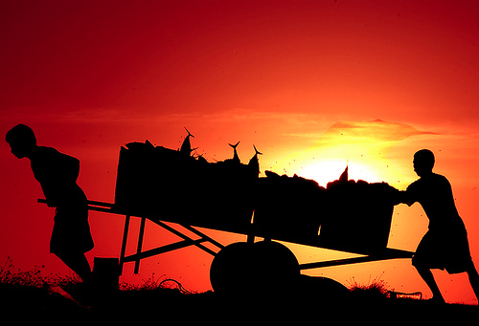
Theme (of 1:1–6:9): Our work ultimately brings us nowhere (1:3).
"What do people get for all their hard work
under the sun?" (NLT)

Slide 31

Proof: Life's many fleeting repetitions bring no real change (1:4-11).

Slide 32
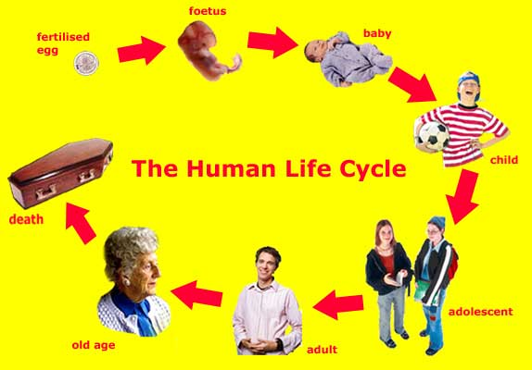
The Human Life Cycle
fetus
fertilized egg
baby
Ecclesiastes
Ceaseless cycles are evident in our generations (1:4).
child
death
Adolescent
old age
adult

Slide 33
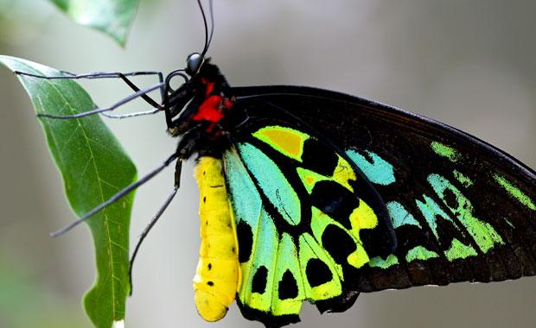
Ceaseless cycles are evident in nature (1:5-7).

Slide 34
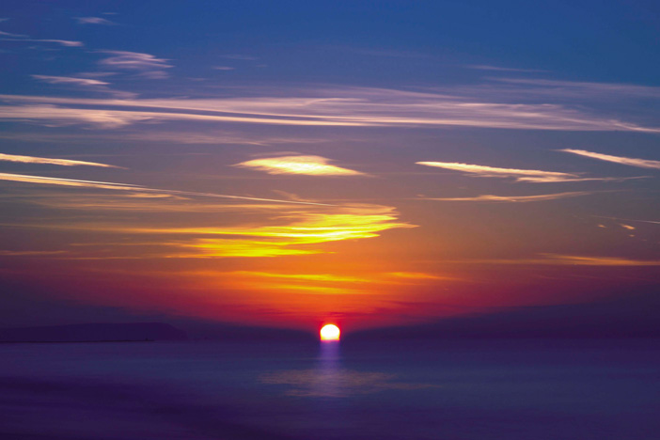
The sun continually rises and sets (1:5).

Slide 35

The wind blows in circles (1:6).

Slide 36
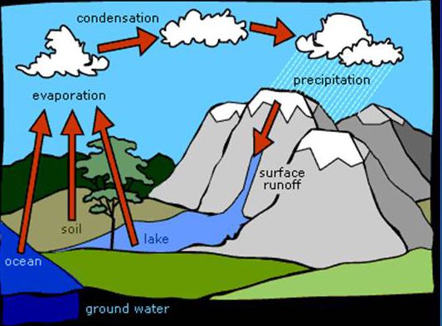
The Water Cycle
condensation
precipitation
evaporation
surface
runoff
soil
lake
ocean
The rivers and seas cycle water endlessly (1:7).
Ecclesiastes
Notes:
http://churchsermonseriesideas.com/?s=ecclesiastes image

Slide 37
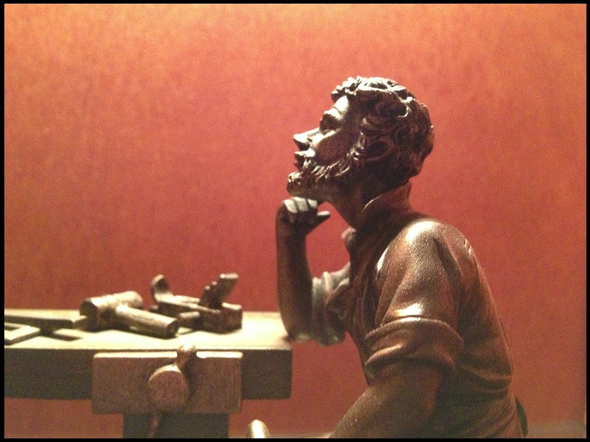
"Nothing under the sun is truly new" (1:9b)
Ceaseless cycles are evident in history (1:8-11)

Slide 38
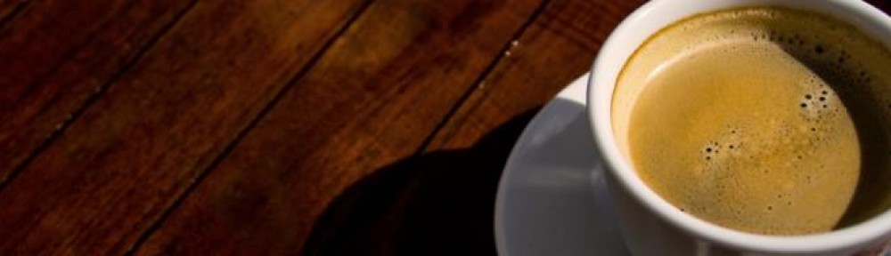
Life's fleeting cycles should move us to seek God.
Main Idea of 1:1-11

Slide 39
2 Fs
Frustration
Find
God
(12:1)
Fleeting
Futile
&
Fear
God
(12:13)

Slide 40
I. Every human endeavor is short-lived (1:2).

Slide 41
II. Life's many cycles are passing (1:3-11).
Ecclesiastes

Slide 42
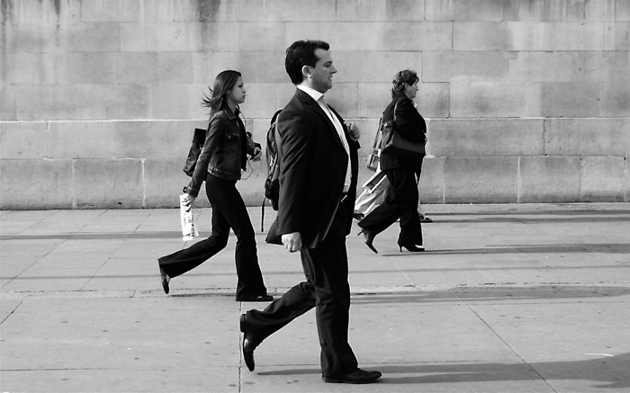
Don't get caught up in the race

Slide 43

Rats often run in circles
Ecclesiastes

Slide 44
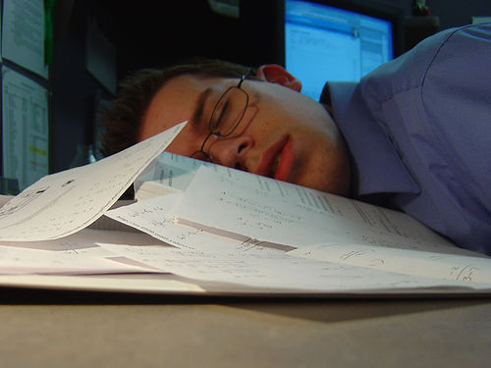
Exhaustion

Slide 45
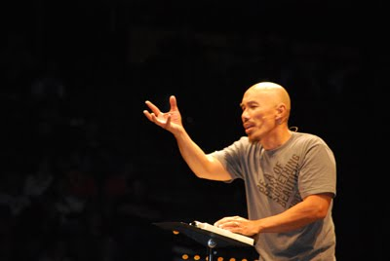
Don't succeed at the wrong thing
"Our greatest fear should not be of failure, but of succeeding at things in life that really don’t matter."
–Francis Chan

Slide 47


OT Preaching link at BibleStudyDownloads.org
Get this presentation and script for free!

